Slide 1

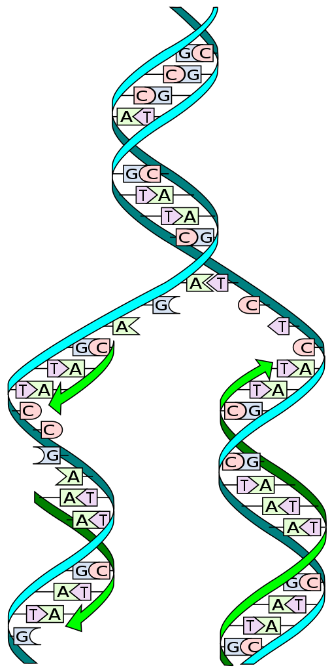
Cracking the DNA protein binding code
Capstone Project Phase B-23-1-R-11
Supervisor: Dr. Zakharia Frenkel
Majd Msallam - Email: msalm46@gmail.com
Mohamed Abo Saleh - Email: abosalehmohamed800@gmail.com

Slide 2

Introduction
The main problem
The lack of understanding of how DNA-binding proteins (DBPs) are able to quickly locate their target sites within the genome.
Our proposed solution
Certain nucleotide sequences in DNA act as "pointers" that direct DBPs to the appropriate binding sites.

Slide 3
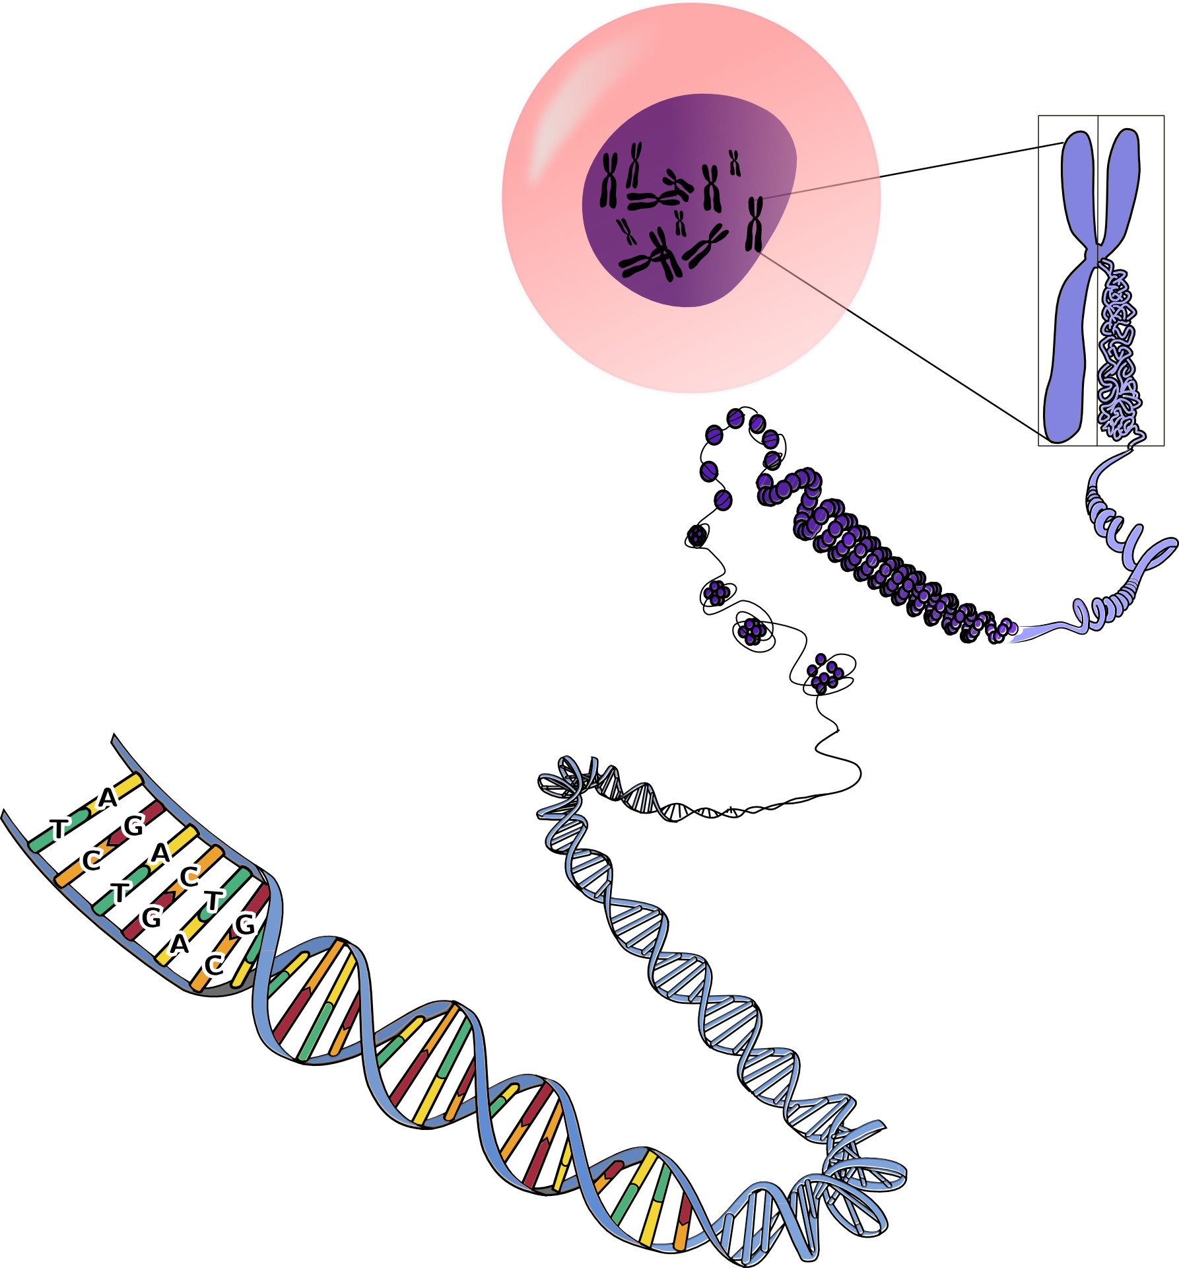
Biological Overview
01
02
DNA
Protein
03
Binding-site
Notes:
Dna explanation based on the parapgraph in the book:
DNA is the molecule that carries genetic information for the development and functioning of an organism
DNA is made of two linked oppositely directed strands that wind around each other to resemble a twisted ladder (double helix)
Each strand is composed of subunits of four types: adenine (A), cytosine (C), guanine (G) or thymine (T)
The two strands are connected by bonds between the bases: A bonds with T, and C bonds with G
Biological functions of the DNA are regulated by proteins (protein factors)
These factors are able to recognize an interval in DNA sequence and specifically interact (connect) with the corresponding place in the DNA molecule.

Slide 4
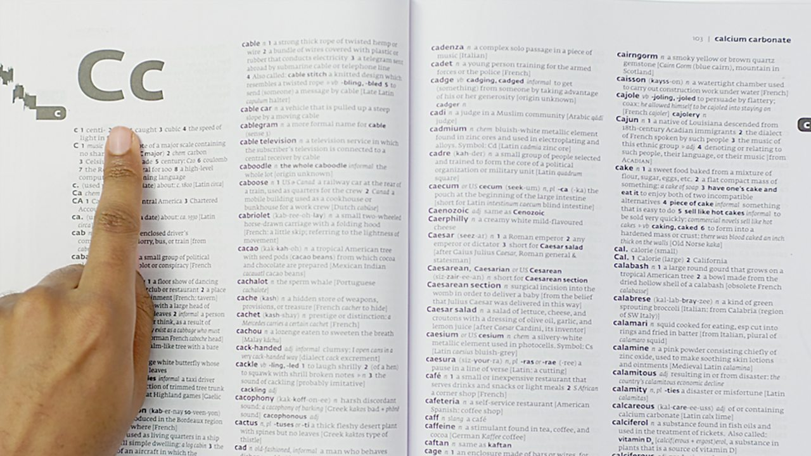
The Problem of Finding Target Sites in DNA
searching a word in a not indexed dictionary.
DBPs face a similar challenge when trying to find their target sites in DNA.
The two concepts are similar in terms of speed.
There must be additional factors.
Notes:
An exam analogy: Imagine taking an exam in a language you don't know, using a dictionary with 10,000 words and 600 pages, but no index. How would you find the word you're looking for?
DBPs (DNA-binding proteins) face a similar challenge when trying to find their target sites in DNA
The speed at which they find their target sites equivalent to having a person open the dictionary, goes to the correct page, points to the specific definition
The rapidity with which DBPs locate their target sites in DNA implies that there must be additional factors involved beyond mere luck.
Down stream up stream

Slide 5
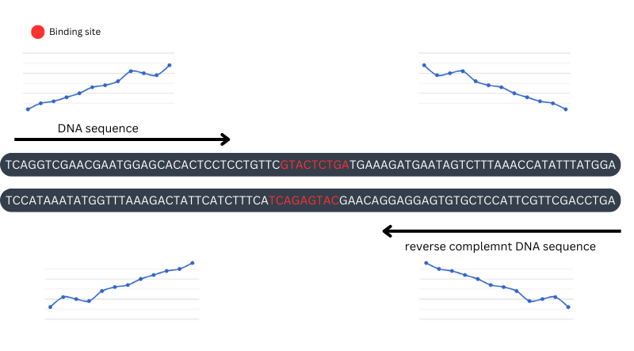
DNA-Protein Interaction Overview
Notes:
Dna explanation based on the parapgraph in the book:
DNA is the molecule that carries genetic information for the development and functioning of an organism
DNA is made of two linked oppositely directed strands that wind around each other to resemble a twisted ladder (double helix)
Each strand is composed of subunits of four types: adenine (A), cytosine (C), guanine (G) or thymine (T)
The two strands are connected by bonds between the bases: A bonds with T, and C bonds with G
Biological functions of the DNA are regulated by proteins (protein factors)
These factors are able to recognize an interval in DNA sequence and specifically interact (connect) with the corresponding place in the DNA molecule.

Slide 6
Patterns of Target Site
There are four cases of patterns that a protein can bind to DNA:
Exact pattern: protein finds target and is strongly bound.
Inexact pattern: protein finds target site but is weakly bound due to substitutions.
Exact pattern but interrupted: protein interacts only with one side of the DNA duplex.
Inexact pattern and not sequentially.
Consider the following example, where the target site is AGCGGGCT:
01
02
03
04
AGCGGGCT
AGCAGGCT
AGCG___GGCT
AGCT___GGCT

Slide 7
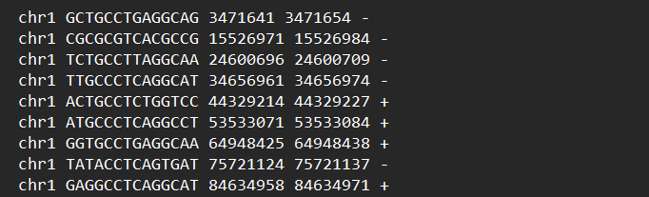
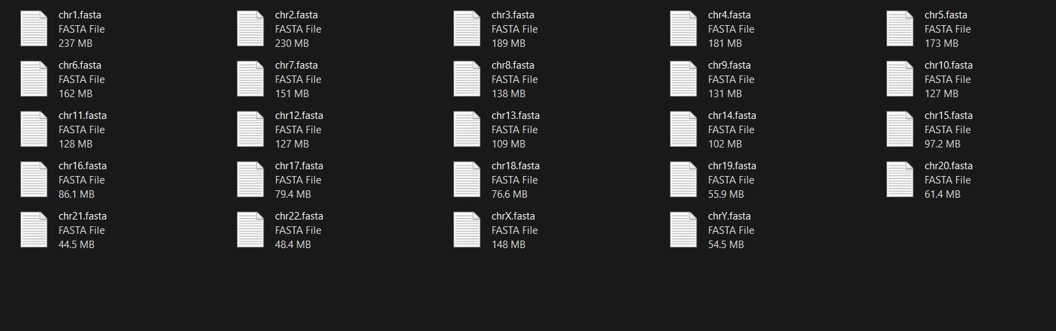
DataBase
01
02
JASPAR CORE database
NCBI
Notes:
The research project involves the use of algorithms to analyze data
The Eukaryotic Nucleic Acid Binding Protein Database (ENPD) is a source of data for the project
ENPD is a comprehensive database that includes information about nucleic acid binding proteins in eukaryotes, such as DNA replication, transcription, and RNA processing.
ENPD provides detailed information about each protein, including its sequence, structure, function, and interactions with other proteins and nucleic acids
The project will also require access to a second database from the National Center for Biotechnology Information (NCBI) website that will include all of the relevant sequences needed for the analysis.

Slide 8
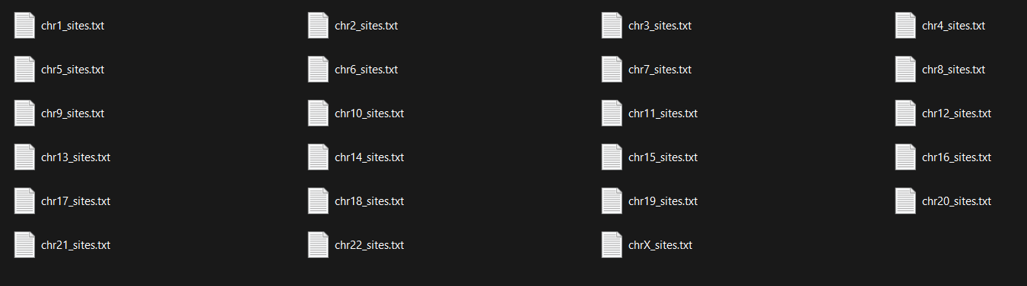
JASPAR CORE database
retrieved a binding sites file from the Jaspar website, encompassing the specific protein's binding locations in the human genome version 38.
The binding sites file was then partitioned into 23 distinct files, corresponding to each individual chromosome's binding sites.

Slide 9
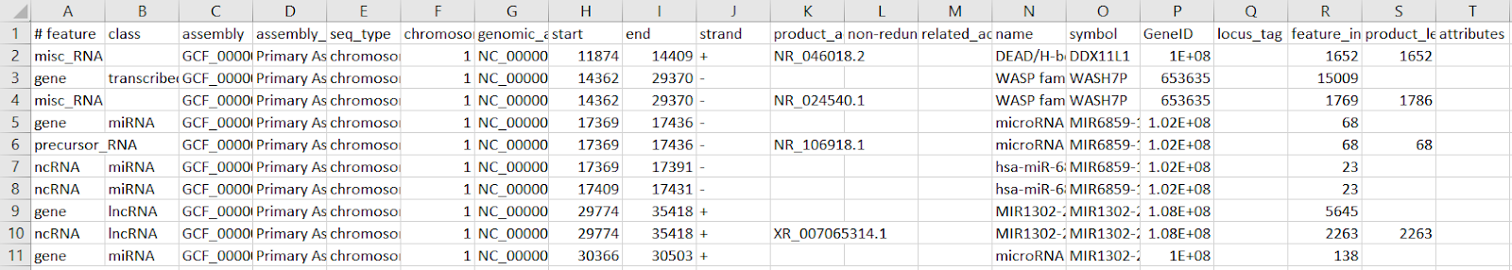
JASPAR CORE database
To enrich our analysis, we obtained the annotation file for GRCh38.p14 Primary Assembly from NCBI, which provided comprehensive details about regions across all chromosomes.
Our primary focus revolved around extracting binding sites that resided within gene regions, known for their functional activity.
Notably, we prioritized the inclusion of distantly located binding sites to ensure a comprehensive analysis, capturing a wider range of regulatory elements.

Slide 10
NCBI
Obtained GRCh38.p14 Primary Assembly dataset from NCBI, representing a specific version of the human reference genome.
GRCh38.p14 serves as a standardized representation of DNA sequence and gene locations in the human genome.
Dataset provides comprehensive and accurate information for genetic analysis and research.
Dataset includes 23 files, each corresponding to an individual chromosome, including the X chromosome.

Slide 11
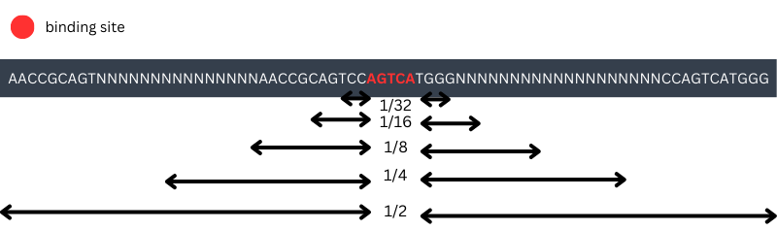
Algorithms
01
Segmented DNA Analysis
DNA sequence divided into segments before and after the binding site at different ratios (1/2, 1/4, 1/8, etc., up to 1/32).
Sliding window moved one position at a time for saving new words.
Iteration through each segment to count word occurrences and store the counts.
Focus on the segment before the binding site (1/32 segment).
Word considered as a potential pointer if it appears more frequently in segments before the binding site.
Reverse complement of the word considered if it appears less frequently in segments before the binding site.
Notes:
Calculate the content of all words in the downstream and upstream regions of the target site.
Select the words with the greatest difference in occurrence between the word and its palindromic pair (such as ATG and CAT) in both regions.
Select the pattern that best meets the mentioned above conditions.

Slide 12
Algorithms
02
Word Occurrences DNA Analysis
DNA sequence analyzed by extracting words from the upstream and downstream regions of the binding site using a sliding window of size k.
Occurrences of each word recorded and unique words saved.
Selection of words based on specific conditions:
Return of words that meet the conditions as potential binding site pointer.
Word occurrence in the downstream region is more frequent than in the upstream region.
Corresponding palindromic word occurrence in the downstream region is less frequent than in the upstream region.
Notes:
Calculate the content of all words in the downstream and upstream regions of the target site.
Select the words with the greatest difference in occurrence between the word and its palindromic pair (such as ATG and CAT) in both regions.
Select the pattern that best meets the mentioned above conditions.

Slide 13
Algorithms
03
Segmented Word Distribution Analysis
DNA sequence divided into segments for analysis.
Sliding window approach used with window size k, moving one position at a time.
Unique sequences encountered added to a set of unique sequences.
Occurrence counts in each segment checked for an ascending order series before the binding site and a descending order series after the binding site.
Complement word occurrences checked for descending order before the binding site and ascending order after the binding site.
Sequences meeting both conditions considered as potential pointers.
Notes:
Calculate the content of all words in the downstream and upstream regions of the target site.
Select the words with the greatest difference in occurrence between the word and its palindromic pair (such as ATG and CAT) in both regions.
Select the pattern that best meets the mentioned above conditions.

Slide 14
Algorithms
04
Potential PWM Pointers
Upload (PFM) from the DNA sequence.
Construct a Position Probability Matrix (PPM) from the PFM.
Building a (PWM) from the PPM.
Calculation of the maximum score in the PWM.
Iteration through the DNA sequence using a sliding window approach with window size "k".
Summation of weights of bases within each window.
Evaluation of conditions for potential pointers:
Return of the list of potential pointers identified in the DNA sequence.
Word score being 0.9 times the maximum score.
More occurrences of the word downstream (before the binding site) than upstream (after the binding site).
Notes:
Calculate the content of all words in the downstream and upstream regions of the target site.
Select the words with the greatest difference in occurrence between the word and its palindromic pair (such as ATG and CAT) in both regions.
Select the pattern that best meets the mentioned above conditions.

Slide 15
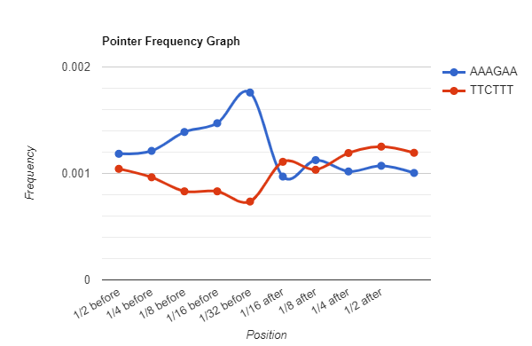
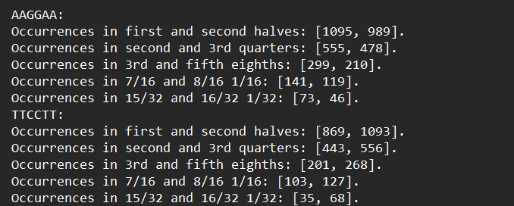
Results 1

Slide 16
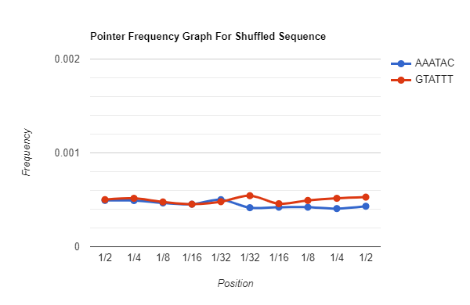
DNA sequence Vs shuffled DNA sequence

Slide 17
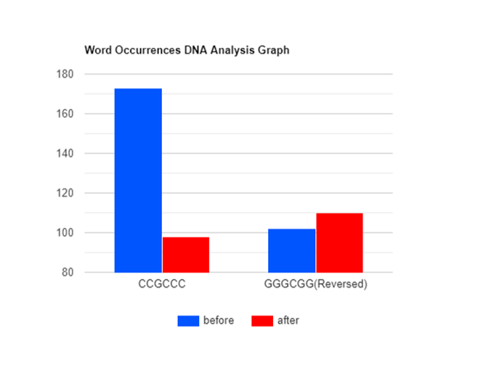
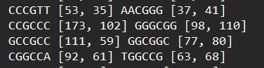
Results 2

Slide 18
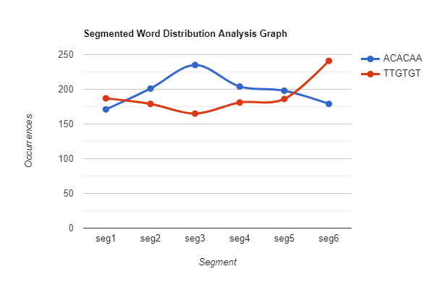
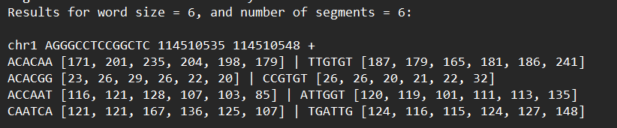
Results 3

Slide 19
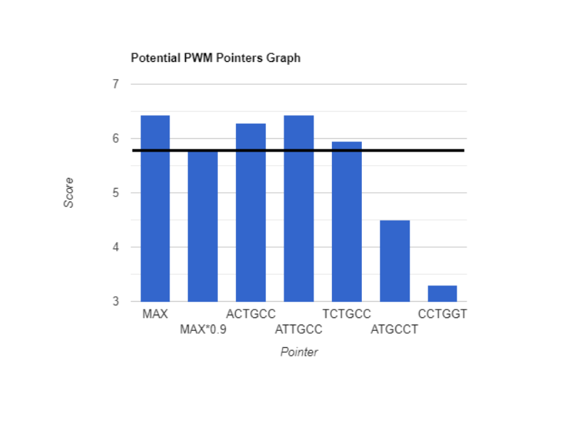
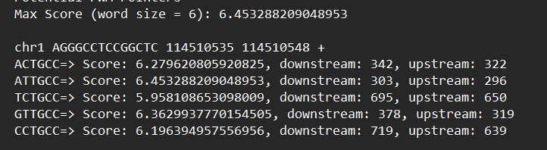
Results 4

Slide 20
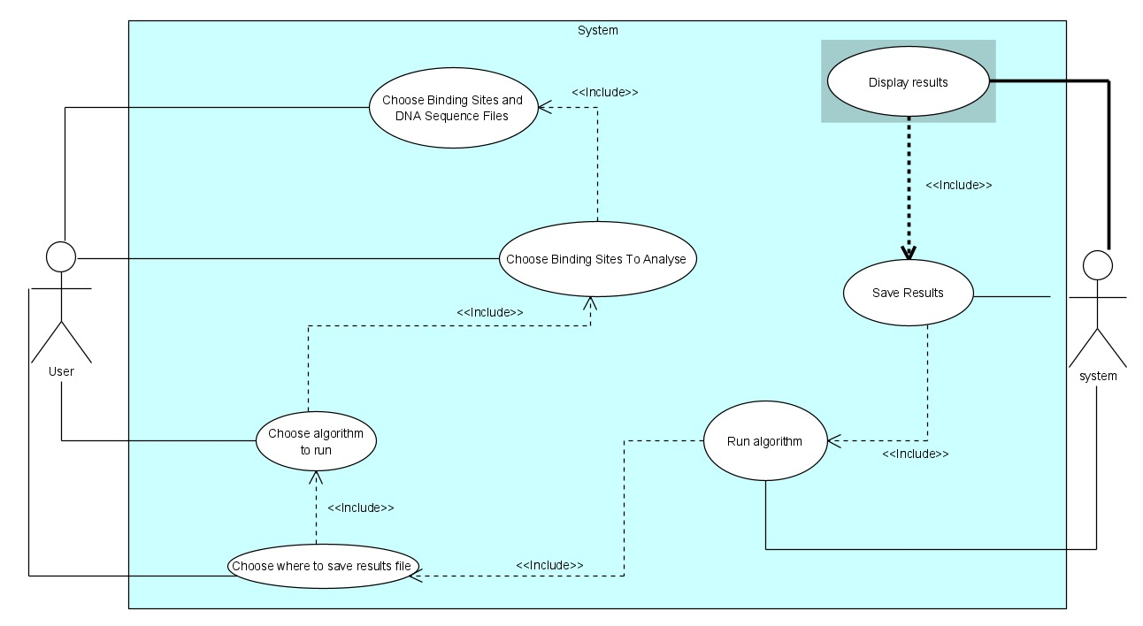
Use Case Diagram

Slide 21
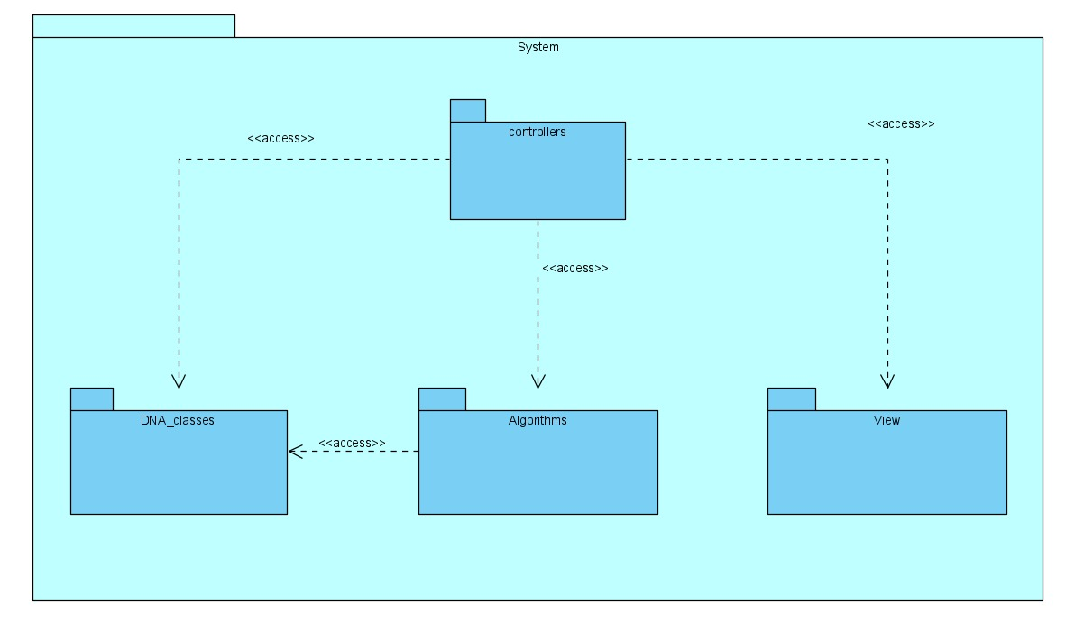
Package diagram

Slide 22
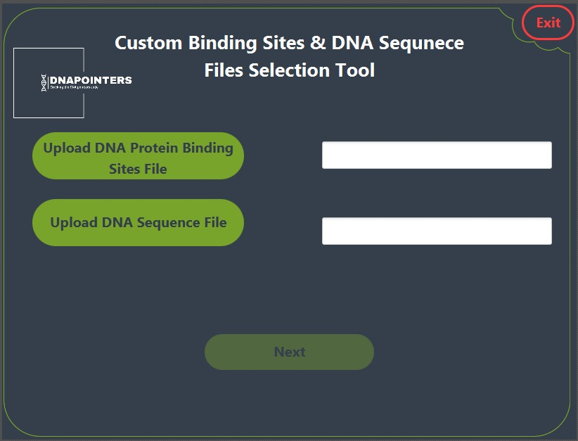
Home page

Slide 23
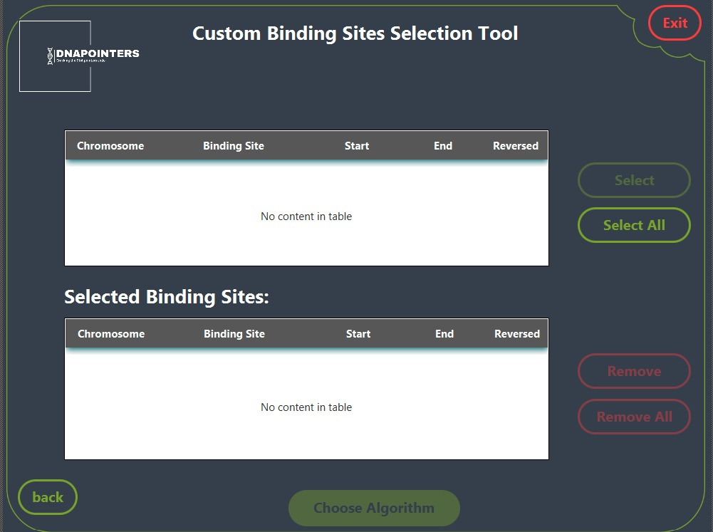
Data selction

Slide 24
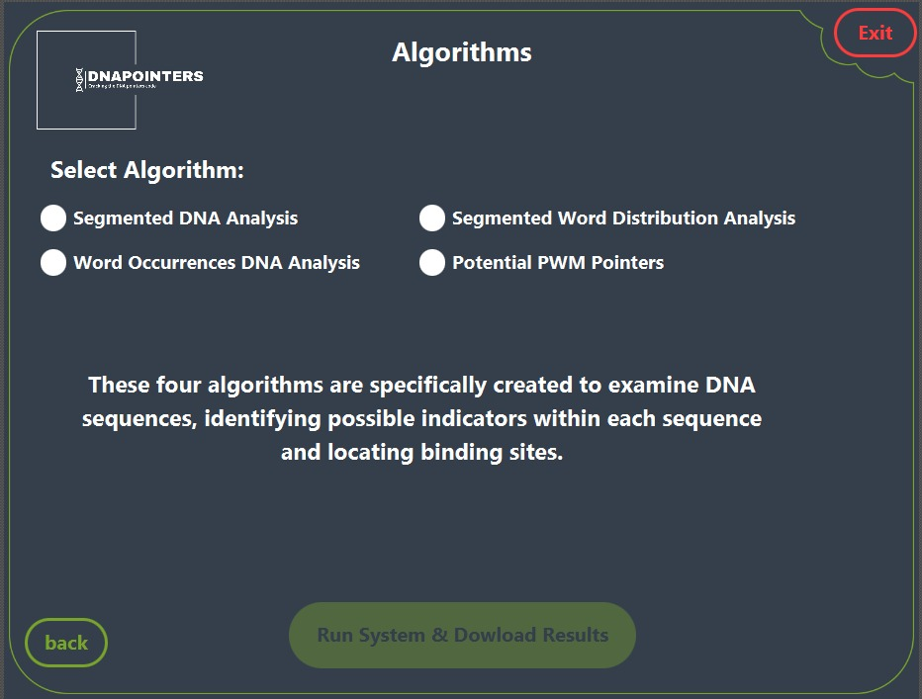
Algorithem selection

Slide 25
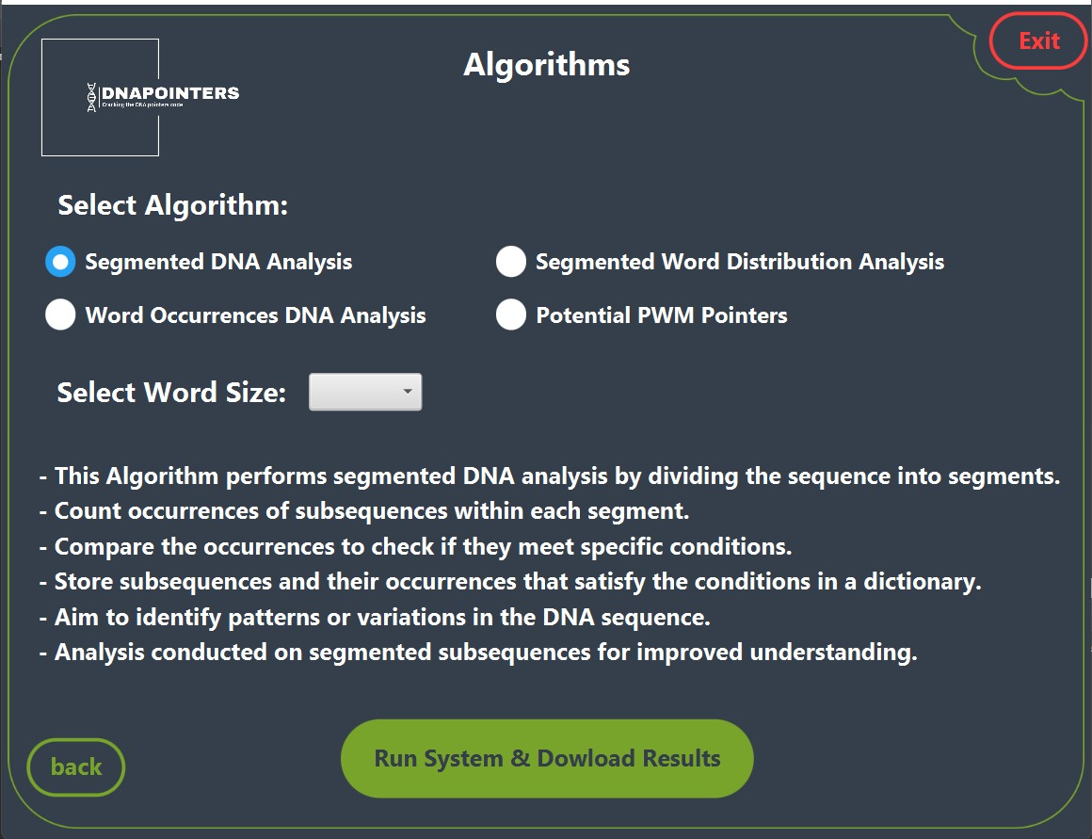
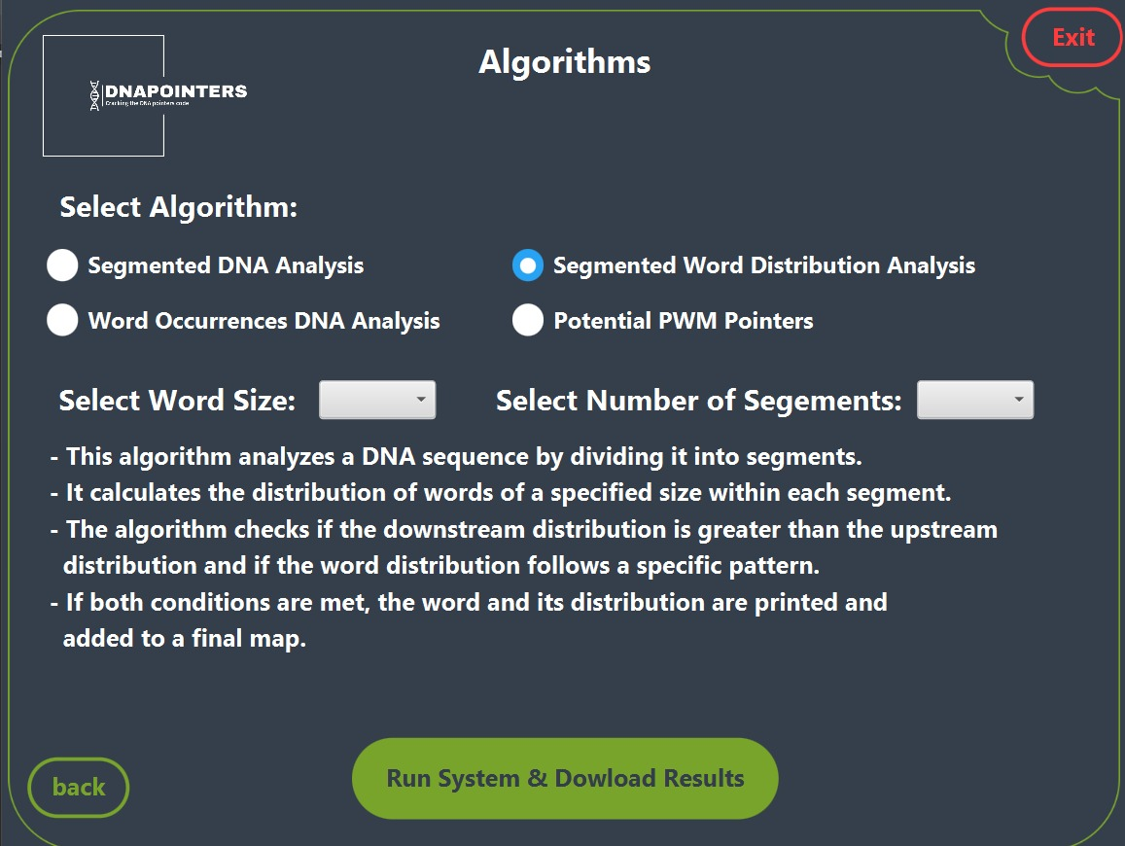
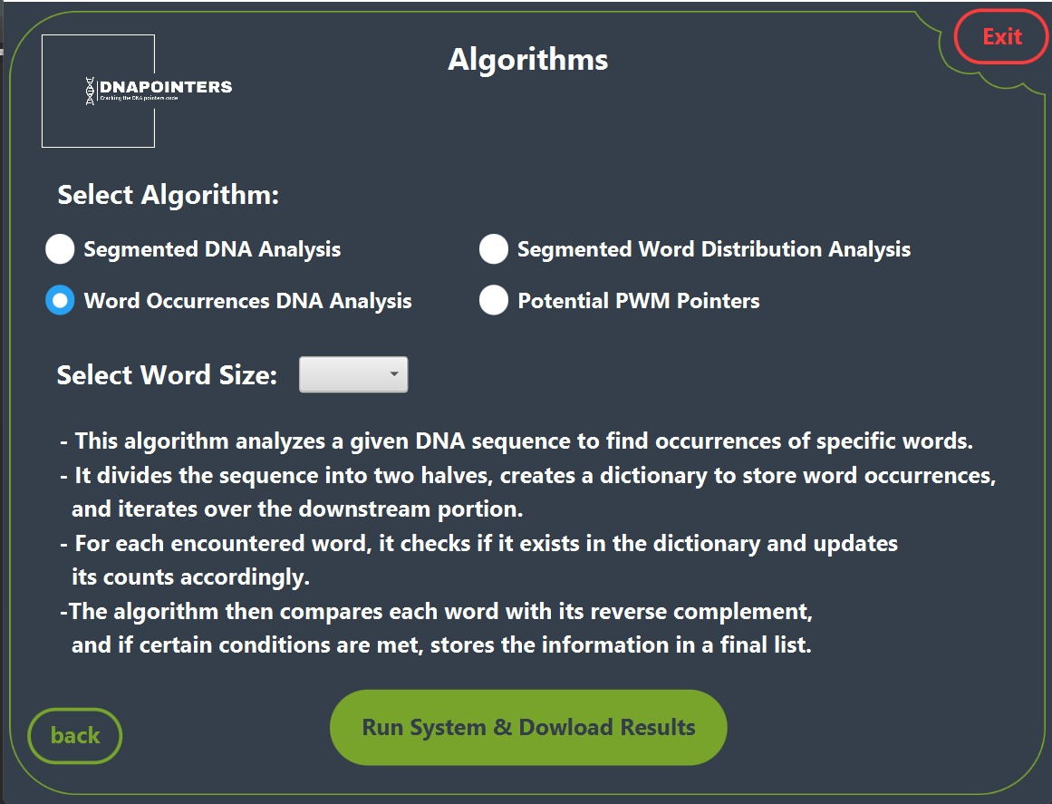
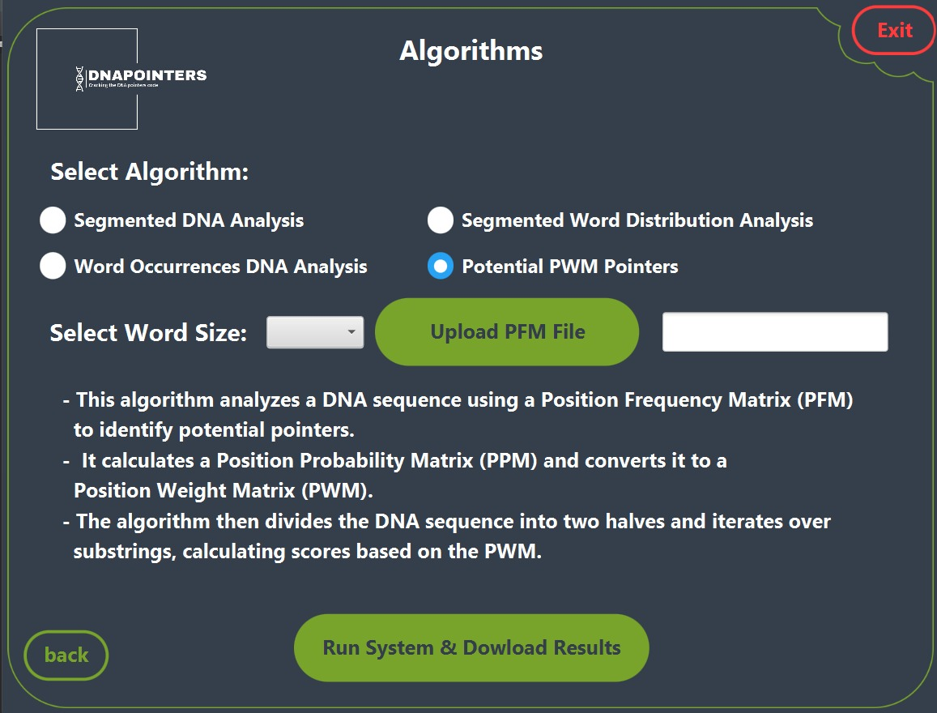
Algorithm explaination

Slide 26

Research verification plan
Test ID | Test Name | Description | Expected results
1. | Input test | Verify that the code can read and process the data from a file correctly. | Return True (the content of the file matches the variable content)
2. | Occurrence Count | Verify that the algorithm is able to accurately count the occurrences of a specific word within a given k-length window. | Return True (number of occurrences in each algorithm matches the number stored in the variable)
3. | Reverse compliment verification | Verify that the algorithms are able to extract the reverse compliment correctly | Return True (if the reverse compliment is correct)

Slide 27
Project development timeline
Database
Construction
Build the tool GUI
01
02
03
04
Prepare Algorithms
Build Use Case diagram

Slide 28
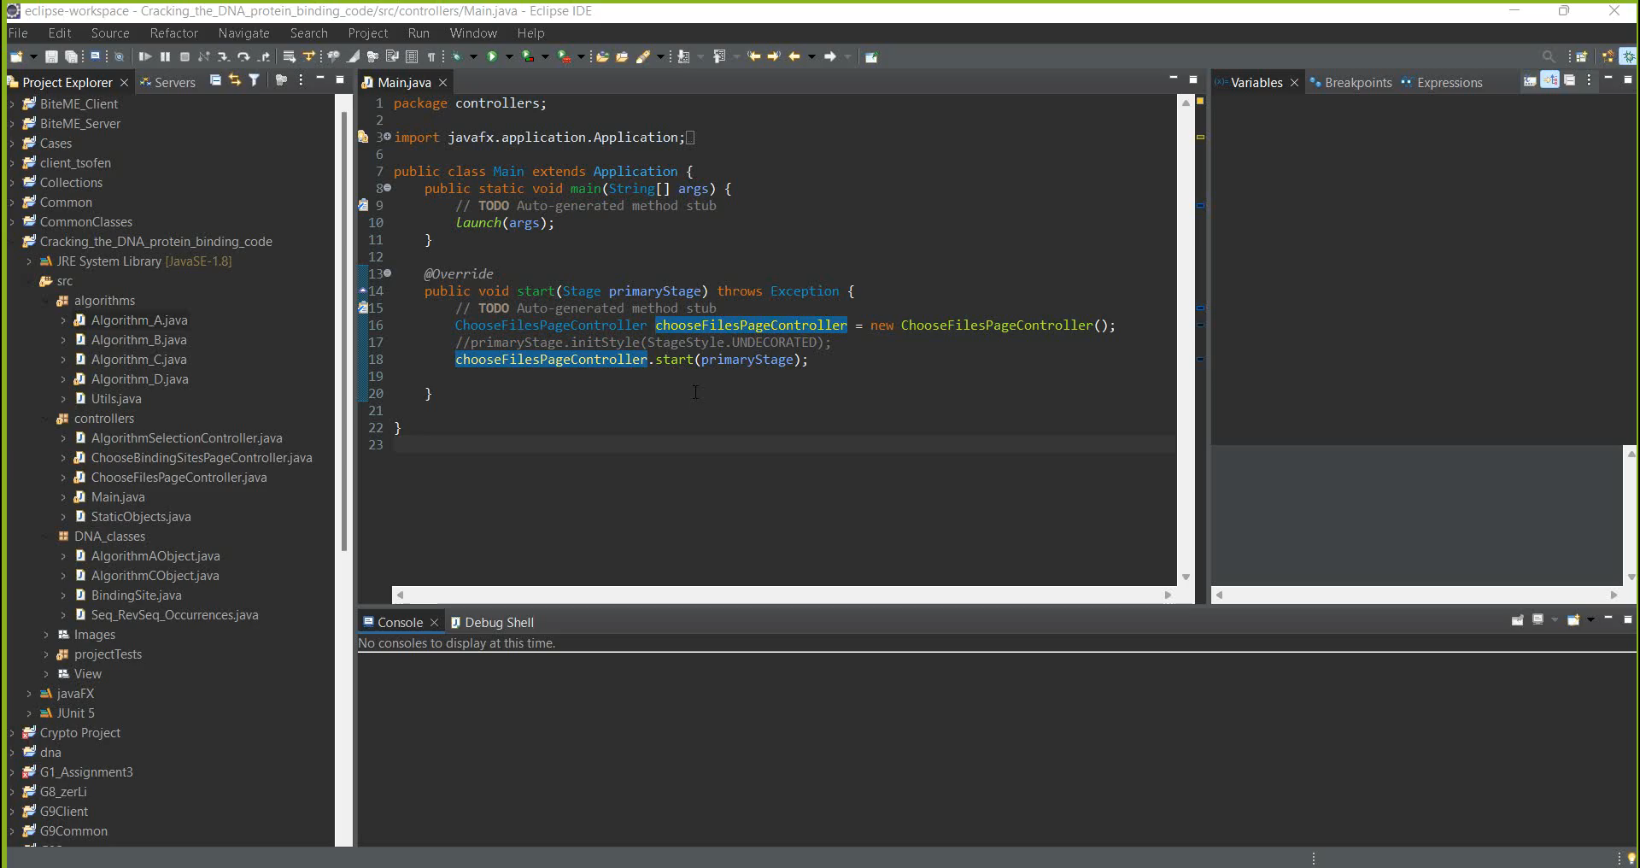

Slide 29

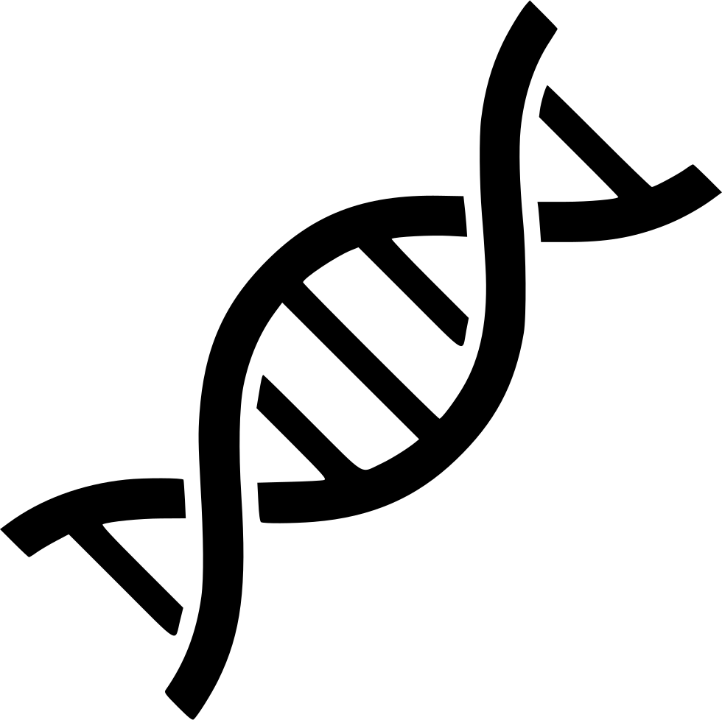
Constraints
01
02
Finding Suitable Database
Biological Concepts
Notes:
Primary challenge: finding a suitable database for research
Encountered many databases with irrelevant data during search
Required careful review of various databases to select appropriate one
Constraint: research in the field of biology, not initially familiar with subject
Had to invest time and effort into understanding necessary biological concepts.

Slide 30

Conclusion
We have developed a tool that utilizes our algorithms to detect potential indicators or references.
Created comprehensive database to support future research efforts in this area.
Identified distinct signal indicating potential pointers in DNA sequences.
Discovered informative subsequences showing consistent frequency patterns near binding sites.
Notes:
Primary challenge: finding a suitable database for research
Encountered many databases with irrelevant data during search
Required careful review of various databases to select appropriate one
Constraint: research in the field of biology, not initially familiar with subject
Had to invest time and effort into understanding necessary biological concepts.

Slide 31
Thank You!
Do you have any questions?
msalm46@gmail.com
abosalehmohamed800@gmail.com

